Slide 1
Downloading and Setting Up Creo SmartbitMesher Tool

Slide 2
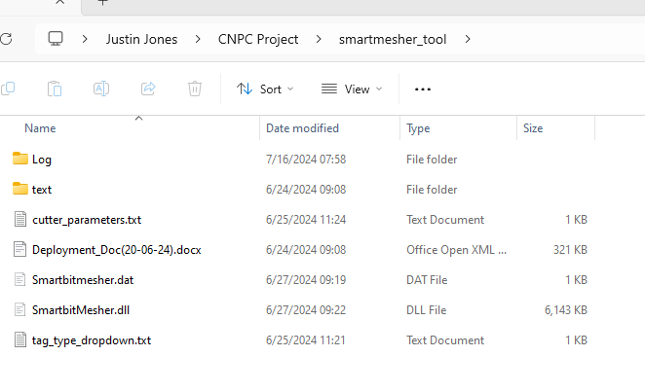
Downloading and Installing
Download latest version of SmartbitMesher tool
Avoid saving extracted Smartbitmesher folder in My Documents
Follow instructions in Deployment Document for Solution Setup
Download cutter_parameters.txt and tag_type_dropdown.txt files and save to smartmesher_tool folder
If files are not available, follow instructions on next two slides

Slide 3
cutter_parameters.txt
Create new blank .txt file and copy text below into it:
cutterface_Chord_Height: 0.5 cutterface_Chord_Angle: 0.5 cutterface_Step_Size: 10 cutterchamfer_Chord_Height: 0.5 cutterchamfer_Chord_Angle: 0.5 cutterchamfer_Step_Size: 10 cutterbody_Chord_Height: 0.5 cutterbody_Chord_Angle: 0.5 cutterbody_Step_Size: 10
Save as cutter_parameters.txt

Slide 4
tag_type_dropdown.txt
Create new blank .txt file and copy text below into it:
Cutterface Cutterbody Cutterchamfer Gaugepad Bitbody
Save as tag_type_dropdown.txt

Slide 5
Last Slide

